Slide 1
A Modern Approach to Predicting CO₂ emissions in Canadian ICE (Internal Combustible Engines)
DATA 621: Fall 2020
Group 3
Zach Alexander, Sam Bellows, Donny Lofland, Joshua Registe, Neil Shah, and Aaron Zalki

Slide 2
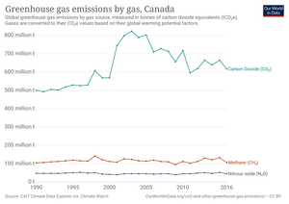
Introduction & Motivation
Climate Change is a top priority in 2019
Economic damage projected 1.5-25% GDP through end of century
Supported by majority of Canadians
Canada dichotomous energy/climate change
10% GDP still fossil fuel related
Major exports are oil, gasoline and cars

Slide 3
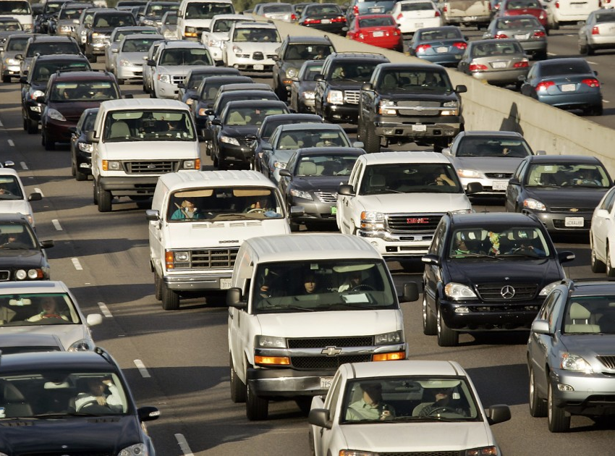
Introduction & Motivation
In 2019 Policy makers adopt Low Carbon Fuel Standard (LCFS) for Canada
Modeled after California
Reduce CO2 emissions in vehicles by fuel source
How can one quantify and predict CO₂ emissions in a diverse automotive fleet such as Canada?

Slide 4
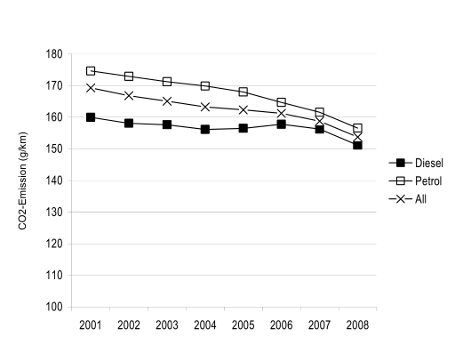
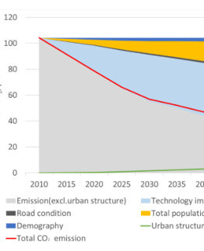
Literature Review
Previous research focused on different representations of vehicle carbon emissions
Theoretical Physical model of vehicle with rolling resistance, friction and other parameters (Fontaras & Panagiota, 2011)
Linear model with factors such as mass, car type, engine or fuel (G. Mellios, 2011)
Aggregate systems of traffic (multiple cars) as a stream (Kevin R. Gurney, 2012)
Traffic dynamics involving changing population (Kii, 2020)

Slide 5
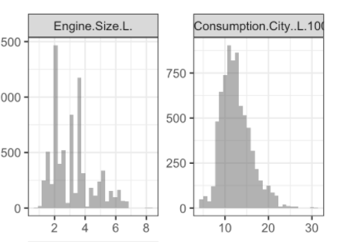
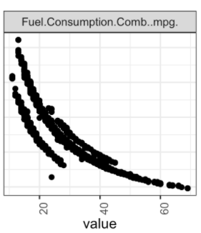
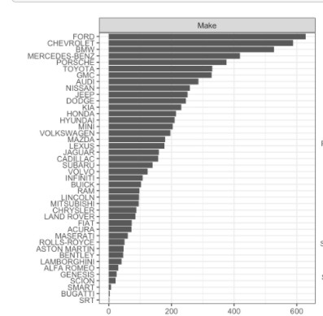
Exploratory Data Analysis
Generated distribution on categorical and numerical features
Engine Size [Displacement]
Fuel Economy
Make of Vehicle
Class of Vehicle [SUV, Compact Mid-Size, etc]
Type of Transmission
Number of Cylinders

Slide 6
References
Full GitHub Repo: https://github.com/djlofland/DS621_F2020_Group3/tree/master/Final%20Project
(2019). Clean Fuel Standard. Environmental Change of Canada. Retrieved from https://www.canada.ca/content/dam/eccc/documents/pdf/climate-change/pricing-pollution/ Clean-fuel-standard-proposed-regulatory-approach.pdf
Fontaras, G., & Panagiota, D. (2011). The evolution of European passenger car characteristics 2000–2010 and its effects on real-world CO₂ emissions and CO₂ reduction policy. Energy Policy.
G. Mellios, S. H. (2011). Parameterisation of fuel consumption and CO₂. JRC Scientific and Technical Reports.
Gouvernement du Canada. (n.d.). Retrieved from Energy and the economy: https://www.nrcan.gc.ca/science-data/data-analysis/energy-data-analysis/energy-facts/energy-and-economy/20062
Hope, C., & Alberth, S. (2008). The Cost of Climate Change: What We’ll Pay if Global Warming. NRDC.
J.A. Paravantis *, D. G. (2006). Trends in energy consumption and carbon dioxide emissions. Technology in Forecasting and Societal Change.

Slide 7
References (cont)
Kevin R. Gurney, I. R. (2012). Quantification of Fossil Fuel CO2 Emissions on the Building/Street. Environmental Science and Technology.
Kii, M. (2020). Reductions in CO₂ Emissions from Passenger Cars in Japan under Population and Technology. Sustainability .
Molico, M. (2019, November 19). Researching the Economic Impacts of Climate Change. Retrieved from Bank of Canada: https://www.bankofcanada.ca/2019/11/researching-economic-impacts-climate-change/
Nadia, P. (2020, Feb 20). Climate Change Rises as a Public Priority. But It’s More Partisan Than Ever. Retrieved from New York Times: https://www.nytimes.com/interactive/2020/02/20/climate/climate-change-polls.html
Shah, M. (2019, October 9). Climate change emerges as one of the top ballot-box issues among voters. Retrieved from https://globalnews.ca/news/6006868/climate-change-federal-election-issue-poll/
Tabuci, H. (2018, April 2). New York Times. Retrieved from Calling Car Pollution Standards ‘Too High,’ E.P.A. Sets Up Fight With California: https://www.nytimes.com/2018/04/02/climate/trump-auto-emissions-rules.html
Toshiko, N. (2003). Energy Modeling on Cleaner Vehicles in Japan. Journal of Cleaner Production.

